Slide 1


Cambodia-Korea Software Consulting
Bootstrap 4
Prepared By:
Ly Pichponreay
Eath Manith

Slide 2
Bootstrap Introduction
What is Bootstrap?
Bootstrap is a free front-end framework for faster and easier web development
Bootstrap includes HTML and CSS based design templates for typography, forms, buttons, tables, navigation, modals, image carousels and many other, as well as optional JavaScript plugins
Bootstrap also gives you the ability to easily create responsive designs

Slide 3
Bootstrap Introduction (Con)
Why Use Bootstrap?
Advantages of Bootstrap:
Easy to use: Anybody with just basic knowledge of HTML and CSS can start using Bootstrap
Responsive features: Bootstrap's responsive CSS adjusts to phones, tablets, and desktops
Mobile-first approach: In Bootstrap 3, mobile-first styles are part of the core framework
Browser compatibility: Bootstrap is compatible with all modern browsers (Chrome, Firefox, Internet Explorer, Safari, and Opera)

Slide 4
Bootstrap Introduction(Con)
Where to Get Bootstrap?
Download Bootstrap from getbootstrap.com
http://getbootstrap.com/
Include Bootstrap from a CDN
<!-- Latest compiled and minified CSS --> <link rel="stylesheet" href="https://maxcdn.bootstrapcdn.com/bootstrap/4.4.1/css/bootstrap.min.css"> <!-- jQuery library --> <script src="https://ajax.googleapis.com/ajax/libs/jquery/3.4.1/jquery.min.js"></script> <!-- Popper JS --> <script src="https://cdnjs.cloudflare.com/ajax/libs/popper.js/1.16.0/umd/popper.min.js"></script> <!-- Latest compiled JavaScript --> <script src="https://maxcdn.bootstrapcdn.com/bootstrap/4.4.1/js/bootstrap.min.js"></script>

Slide 5
Create First Web Page With Bootstrap
1. Add the HTML5 doctype
<!DOCTYPE html> <html lang="en"> <head> <meta charset="utf-8"> </head> </html>
2. Bootstrap 3 is mobile-first
<meta name="viewport" content="width=device-width, initial-scale=1">
3. Containers
The .container class provides a responsive fixed width container
The .container-fluid class provides a full width container, spanning the entire width of the viewport

Slide 6
Bootstrap Grid System
Bootstrap’s grid system is a powerful mobile-first flexbox grid which is used to build layouts of all shapes and sizes. There are twelve column system for the Bootstrap grid system.
Bootstrap’s grid system uses a series of containers, rows, and columns to layout and align content.
All bootstrap columns are centered in the page with the parent .container.
There are two types of containers, which provide a means to center and horizontally pad your site’s contents.
1. Use .container for a responsive pixel width
2. Use .container-fluid for width:100% across all viewport and device sizes.

Slide 7
Bootstrap Grid System (Cont)
Example
<div class="container"> <div class="row">
<div class="col-sm-4">
One of three columns
</div>
<div class="col-sm-4">
One of three columns
</div>
<div class="col-sm-4">
One of three columns
</div>
</div>
</div>

Slide 8

Bootstrap Grid System (Cont)
Grid options
 | Extra small (<575px) | Small (>=576px) | Medium (>=768px) | Large (>=992px) | Extra large (>=1200px)
Class prefix | .col- | .col-sm- | .col-md- | .col-lg- | .col-xl-
# of columns | 12

Slide 9
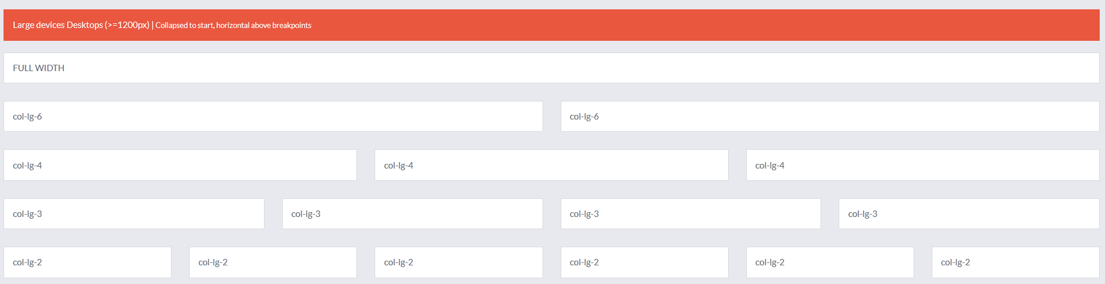
Bootstrap Grid System (Cont)

Slide 10
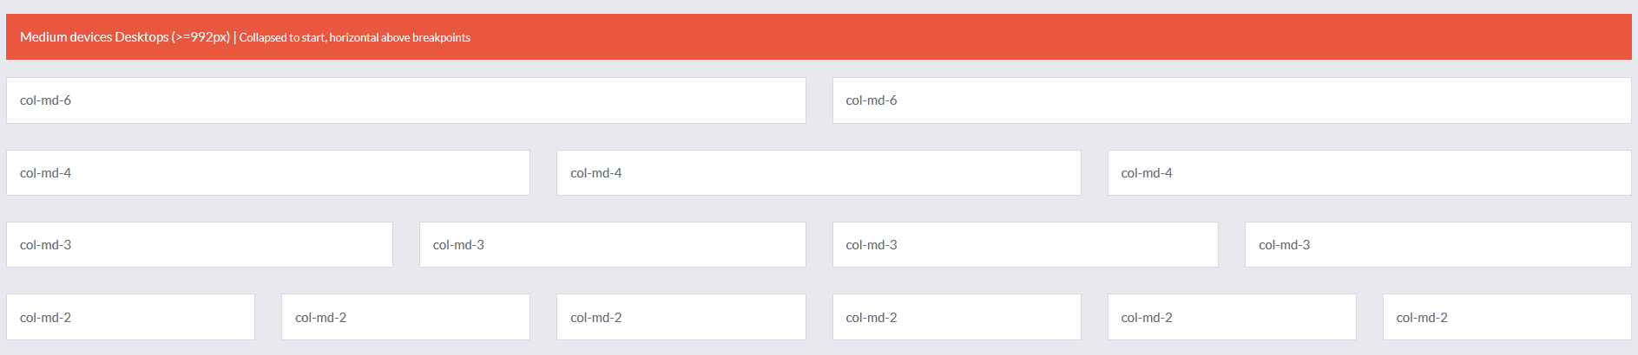
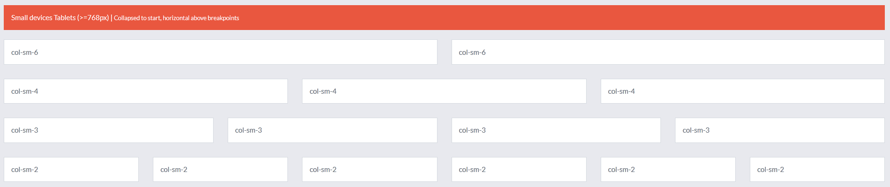
Bootstrap Grid System (Cont)

Slide 11
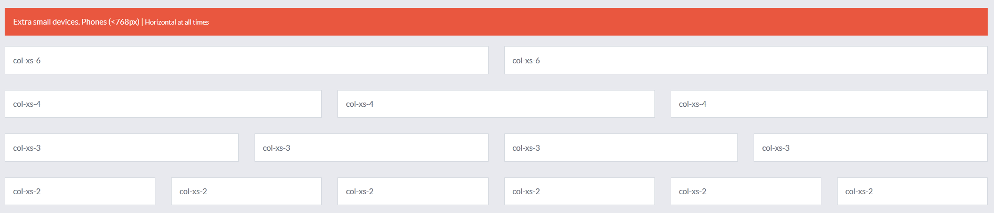
Bootstrap Grid System (Cont)
More details of Bootstrap’s grid system: https://getbootstrap.com/docs/4.4/layout/grid/

Slide 12
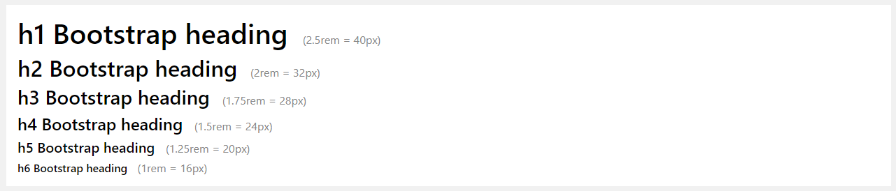
Bootstrap Text/Typography
Bootstrap 4's global default font-size is 16px, with a line-height of 15.
This is applied to the <body> and all paragraphs.
In addition, all <p> elements have a bottom margin that equals half their computed line-height (16px by default).
Example
Bootstrap headings:

Slide 13
Bootstrap Text/Typography (Con)
Class | Description
.font-weight-bold | Bold text
.font-weight-bolder | Bolder text
.font-italic | Italic text
.font-weight-light | Light weight text
.font-weight-lighter | Lighter weight text
.font-weight-normal | Normal text
.lead | Makes a paragraph stand out
.small | Indicates smaller text (set to 85% of the size of the parent)
.text-left | Indicates left-aligned text
.text-center | Indicates center-aligned text
.text-right | Indicates right-aligned text

Slide 14
Bootstrap Text/Typography (Con)
Class | Description
.text-justify | Indicates justified text
.text-nowrap | Indicates no wrap text
.text-lowercase | Indicates lowercased text
.text-uppercase | Indicates uppercased text
.text-capitalize | Indicates capitalized text
.initialism | Displays the text inside an <abbr> element in a slightly smaller font size
.list-unstyled | Removes the default list-style and left margin on list items (works on both <ul> and <ol>). This class only applies to immediate children list items (to remove the default list-style from any nested lists, apply this class to any nested lists as well)
.list-inline | Places all list items on a single line
.dl-horizontal | Lines up the terms (<dt>) and descriptions (<dd>) in <dl> elements side-by-side. Starts off like default <dl>s, but when the browser window expands, it will line up side-by-side
.pre-scrollable | Makes a <pre> element scrollable
More details of Bootstrap’s Text/Typography: https://www.w3schools.com/bootstrap4/bootstrap_typography.asp

Slide 15
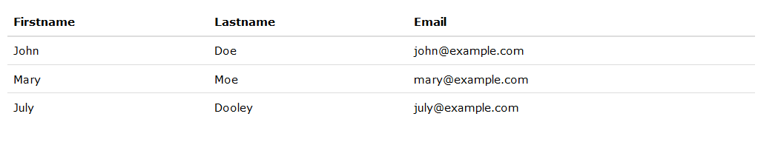
Bootstrap Tables
A basic Bootstrap table has a light padding and only horizontal dividers.
The .table class adds basic styling to a table:

Slide 16
Bootstrap Tables (Con)
Class | Description
.table | Adds basic styling to a table
.table-striped | Adds zebra-stripes to a table
.table-bordered | Adds borders on all sides of the table and cells
.table-hover | Adds a hover effect (grey background color) on table rows
.table-borderless | Removes borders from the table

Slide 17
Bootstrap Tables (Con)
Class | Description
.table-primary | Blue: Indicates an important action
.table-success | Green: Indicates a successful or positive action
.table-danger | Red: Indicates a dangerous or potentially negative action
.table-info | Light blue: Indicates a neutral informative change or action
.table-warning | Orange: Indicates a warning that might need attention
.table-active | Grey: Applies the hover color to the table row or table cell
.table-secondary | Grey: Indicates a slightly less important action
.table-light | Light grey table or table row background
.table-dark | Dark grey table or table row background

Slide 18
Bootstrap Tables (Con) – Responsive Table
Class | Description
.table-responsive | Creates a responsive table: an horizontal scrollbar is added to the table on screens that are less than 992px wide (if needed). When viewing on anything larger than 992px wide, there is no difference.
.table-responsive-sm | Screen width: <576px
.table-responsive-md | Screen width: <768px
.table-responsive-lg | Screen width: <992px
.table-responsive-xl | Screen width: <1200px
More details of Bootstrap’s Table: https://www.w3schools.com/bootstrap4/bootstrap_tables.asp

Slide 19
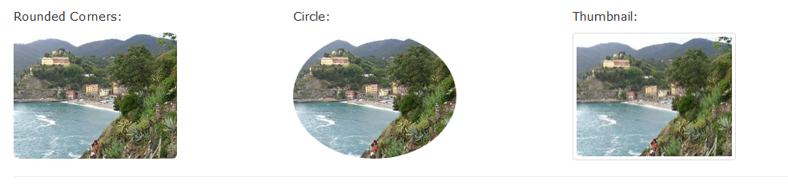
Bootstrap Images
Rounded Corners
The .rounded class adds rounded corners to an image.
Circle
The .rounded-circle class shapes the image to a circle.

Slide 20
Bootstrap Images (Con)
Thumbnail
The .img-thumbnail class shapes the image to a thumbnail (bordered).
Responsive Images
Create responsive images by adding an .img-fluid class to the <img> tag. The image will then scale nicely to the parent element. It includes max-width:100%; and height: auto.
Aligning Images
Float an image to the right with the .float-right class or to the left with .float-left class.

Slide 21
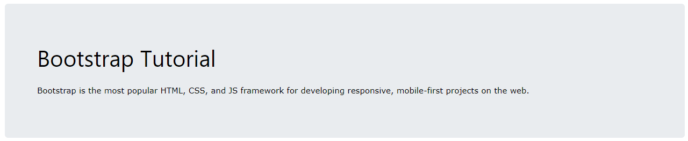
Bootstrap Jumbotron and Page Header
Creating a Jumbotron
A jumbotron indicates a big grey box for calling extra attention to some special content or information.
Tip: Inside a jumbotron you can put nearly any valid HTML, including other Bootstrap elements/classes.
Use a <div> element with class .jumbotron to create a jumbotron

Slide 22
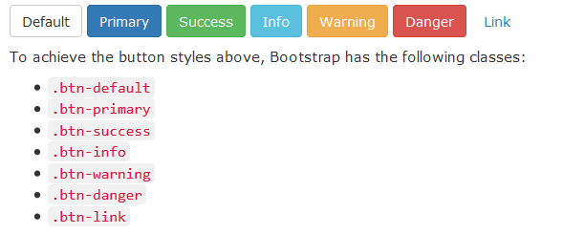
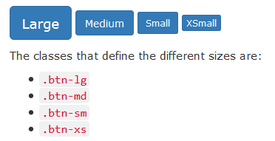
Bootstrap Buttons
The class .active makes a button appear pressed, and the class .disabled makes a button unclickable

Slide 23
Bootstrap Buttons (Con)
Bootstrap 4 provides eight outline/bordered buttons.
.btn-outline-primary
.btn-outline-secondary
.btn-outline-success
.btn-outline-danger
.btn-outline-warning
.btn-outline-info
.btn-outline-light
.btn-outline-dark

Slide 24
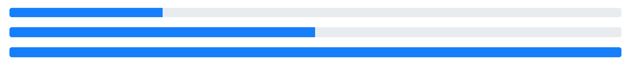
Bootstrap Progress bars
To create a default progress bar, add a .progress class to a container element and add the .progress-bar class to its child element. Use the CSS width property to set the width of the progress bar.
Example
<div class="progress"> <div class="progress-bar" style="width:70%"></div> </div>

Slide 25

Bootstrap Pagination
To create a basic pagination, add the .pagination class to an <ul> element. Then add the .page-item to each <li> element and a .page-link class to each link inside <li>.
<ul class="pagination"> <li class="page-item"><a class="page-link" href="#">Previous</a></li> <li class="page-item"><a class="page-link" href="#">1</a></li> <li class="page-item"><a class="page-link" href="#">2</a></li> <li class="page-item"><a class="page-link" href="#">3</a></li> <li class="page-item"><a class="page-link" href="#">Next</a></li> </ul>

Slide 26


Bootstrap Pagination (Con)
Class | Description
.active | is used to "highlight" the current page
.disabled | is used for un-clickable links

Slide 27
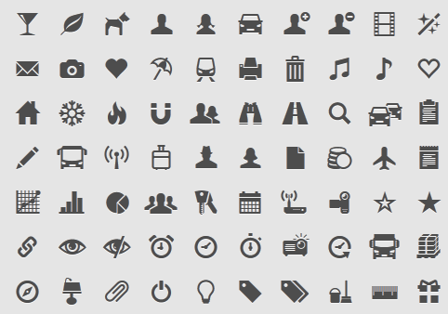
Bootstrap Glyphicons and Badges
Bootstrap provides 200 glyphicons from the Glyphicons Halflings set.
Glyphicons can be used in text, buttons, toolbars, navigation, forms, etc.
Here are some examples of glyphicons:
Envelope glyphicon:
Print glyphicon:
Search glyphicon:
Download glyphicon:
Font Awesome

Slide 28
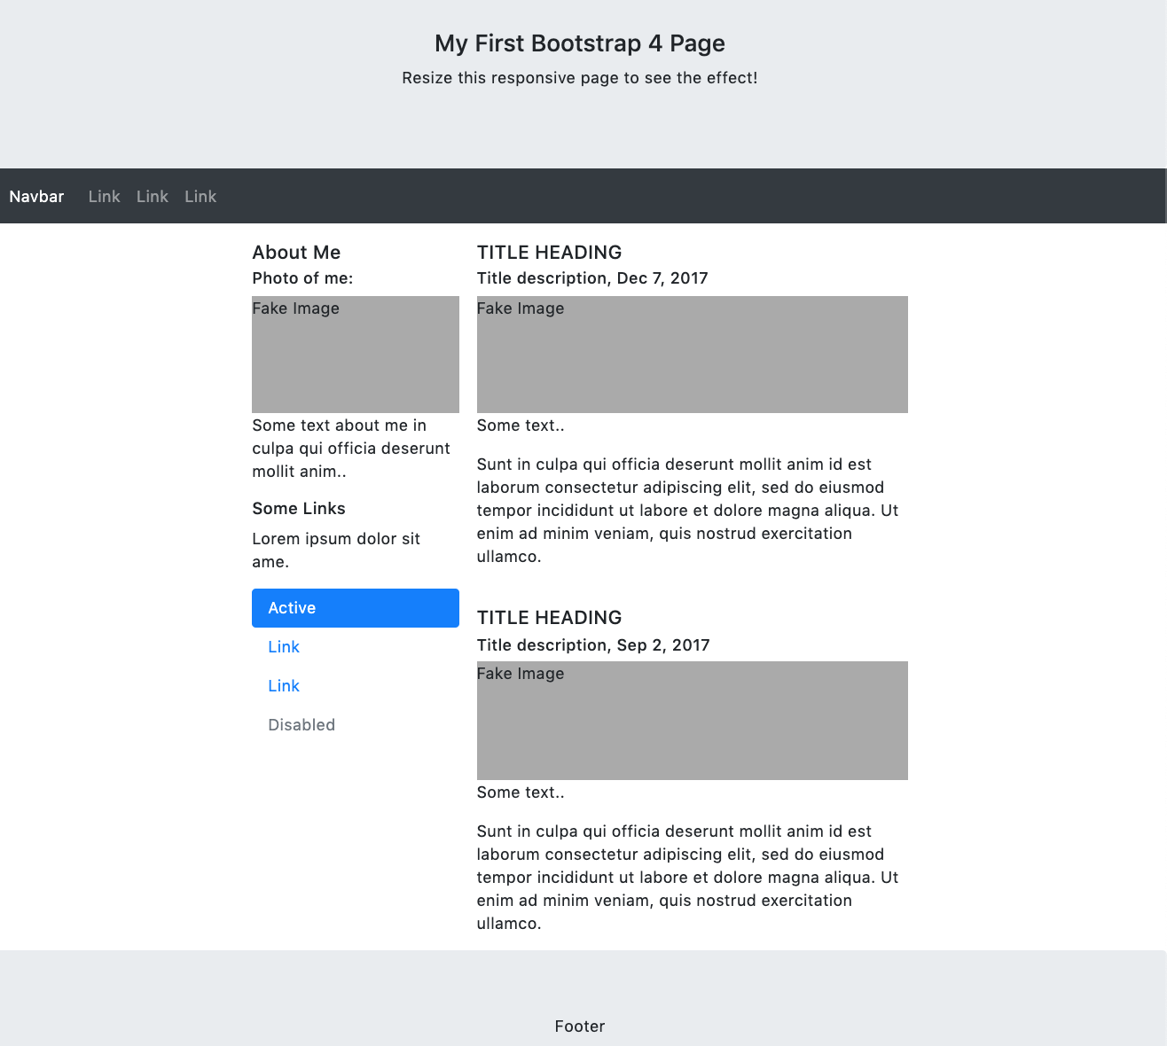
Bootstrap Theme
We have created a responsive starter template with Bootstrap 4.
You are free to modify, save, share, and use it in your projects:
https://www.w3schools.com/bootstrap4/bootstrap_templates.asp

Slide 29
Thank You!

